Slide 1
Stock Performance Dashboard: A Yearly Analysis of Nifty 50 Stocks
By Arjun

Slide 2
Objective
To develop an interactive and informative dashboard that visualizes the performance of Nifty 50 stocks over the past year, enabling investors and analysts to gain meaningful insights through price trends, volume changes, and top performers.
Problem Statement
The Stock Performance Dashboard aims to provide a comprehensive visualization and analysis of the Nifty 50 stocks' performance over the past year. The project will analyze daily stock data, including open, close, high, low, and volume values. Clean and process the data, generate key performance insights, and visualize the top-performing stocks in terms of price changes, as well as average stock metrics. The solution will offer interactive dashboards using Streamlit and Power BI to help investors, analysts, and enthusiasts make informed decisions based on stock performance trends.

Slide 3
Scope of the Project
Analysis of Nifty 50 stocks over the last 12 months.
Data includes: Open, Close, High, Low, Volume.
Data processing, cleaning, and feature engineering.
Visualizations of:
Cumulative returns
Daily returns
Top gainers and losers
Average price and volume trends
Monthly performance summary
Volatility analysis
Correlation heatmap between stocks
Dashboards built using:
Streamlit (Python-based, interactive)
Power BI (Business Intelligence visuals)

Slide 4
Data Collection
Source: Public stock market APIs or data providers (e.g., Yahoo Finance, NSE website, Alpha Vantage)
Data Format: .Yaml and CSV/JSON format
Timeframe: Daily stock data for 1 year
Features Collected:
Date
Stock Symbol
Open Price
Close Price
High Price
Low Price
Volume

Slide 5
Technologies and Tools Used
Component | Tool/Language
Data Collection | Python (yfinance / NSEpy / requests)
Data Analysis | Pandas, NumPy
Visualization | Plotly, Matplotlib
Dashboard Development | Streamlit
Business Dashboard | Power BI
Others | SQL, Excel (optional for preprocessing)

Slide 6
Data Preprocessing Steps
Handle missing or null values
Convert date columns to datetime format
Calculate daily returns
Calculate cumulative returns
Normalize price and volume metrics for comparison
Group by stock symbols for aggregation
Resample for monthly trends
Key Metrics Analyzed
Daily Return: (Close - Open) / Open
Cumulative Return: (Current Price / Initial Price) - 1
Volatility: Standard deviation of daily returns
Average Daily Volume
Monthly Performance: Avg. return per month
Top 5 Gainers and Losers (Monthly & Yearly)
Correlation between stocks (Pearson)

Slide 7
Dashboard Features
Streamlit Dashboard
Search by stock name
Filter by date range
Interactive charts (Plotly)
Download data as CSV
Tabs for:
Overview
Cumulative Return
Daily Return
Top Gainers/Losers
Volatility
Correlation Matrix
Power BI Dashboard
Monthly and Yearly analysis of:
Price change %
Volume trends
Sector-wise performance (if included)
Matrix of top/bottom 5 stocks
Heatmap and slicers for filtering by date/stock

Slide 8
Benefits of the Solution
Helps investors identify high-performing stocks
Tracks volatility to support risk management
Visualizes correlation for portfolio diversification
Simplifies stock analysis for beginners and professionals
Offers dual dashboards: Web-based (Streamlit) and BI (Power BI)
Challenges and Limitations
Real-time data access may be rate-limited (depending on API)
Lag in Power BI data refresh without premium version
Visualization performance can degrade with very large datasets
Stock splits/dividends not accounted for unless adjusted in preprocessing

Slide 9
Conclusion
This Stock Performance Dashboard enables a clear, insightful view into the historical trends and performance of Nifty 50 stocks over a year. The combined power of Python, Streamlit, and Power BI provides both analytical depth and user-friendly visualizations, making it a valuable tool for investors and analysts.
Future Enhancements
Add real-time stock update feature (WebSocket/API polling)
Integrate sentiment analysis from news headlines
Include technical indicators (e.g., RSI, MACD)
Mobile-responsive dashboard using Streamlit + Bootstrap
Export dashboard to PDF reports

Slide 10
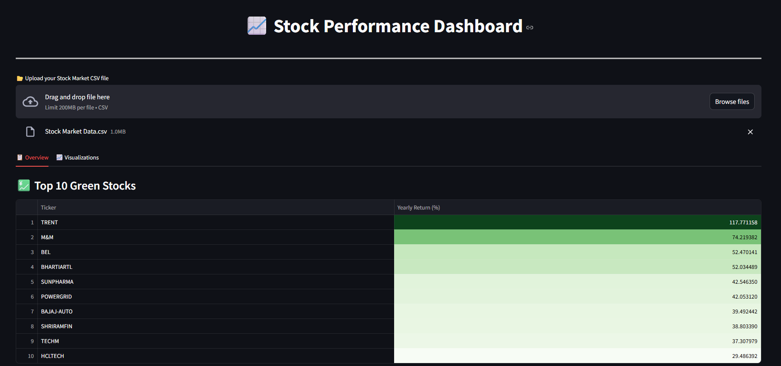
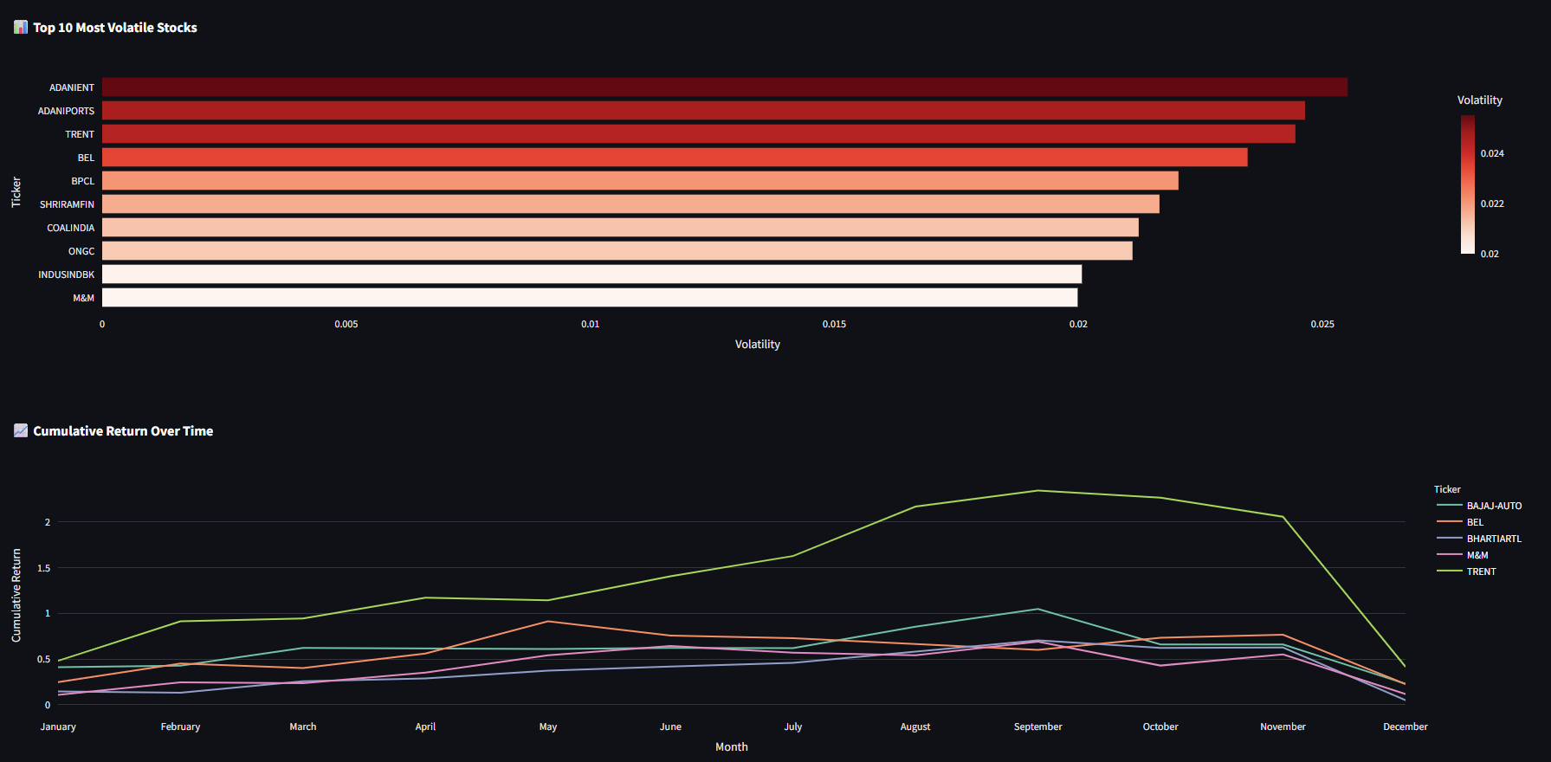
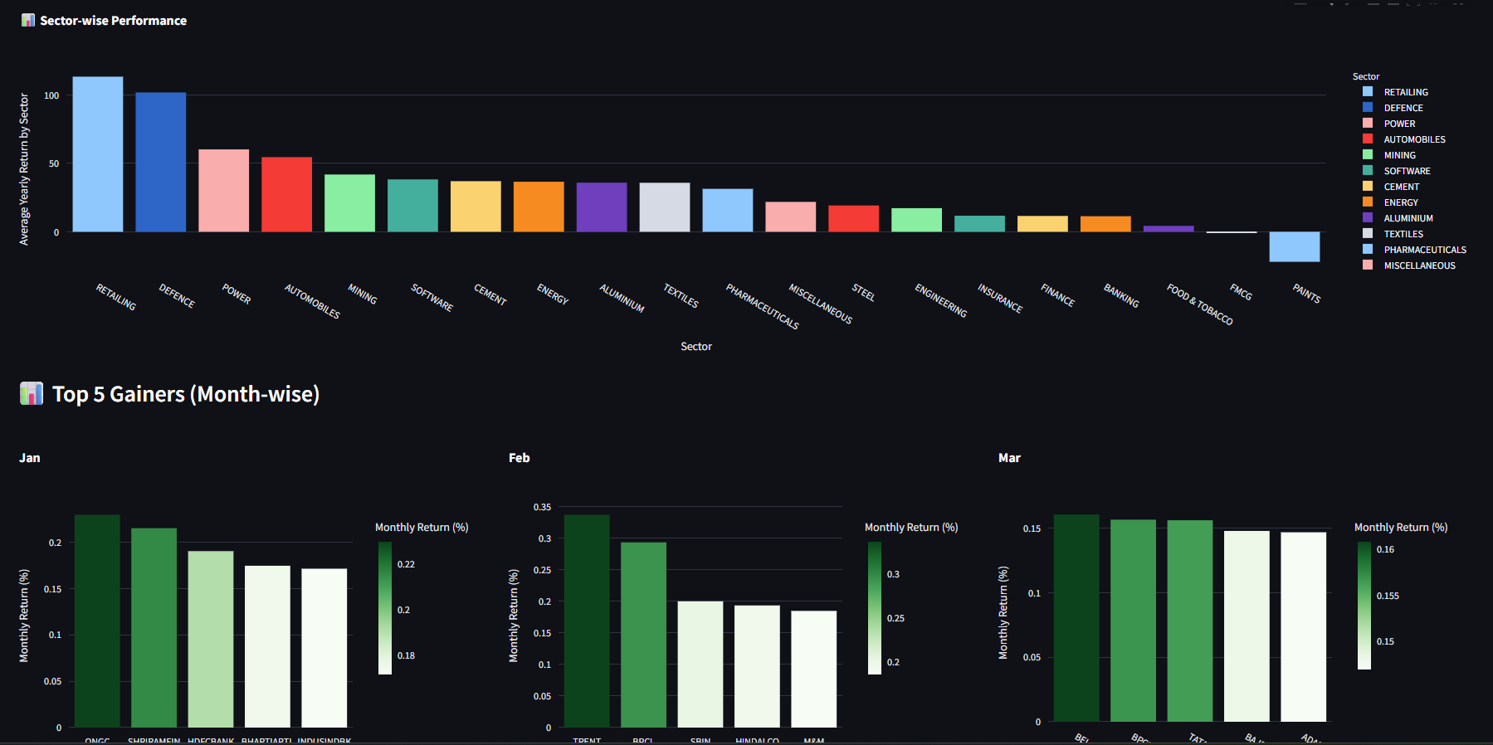
Screenshots

